Slide 1

Immersed – Firmware Design Challenge
Ali Rahimi

Slide 2
Objective
I was tasked with designing firmware for a smart battery pack that powers a headset and simultaneously allows charging from a USB Input.
Because Immersed was open to the architectural choices I went with my strengths.
A good hardware design should support a good firmware design.
What’s included in this presentation is the following:
Key design decisions
A block Diagram
A schematic of the design
The firmware for 3 pieces of the challenge requirements

Slide 3
Assumptions
This design has multiple assumptions.
Configuration: 2 cell battery in series (2S), 5000 mAh battery - Samsung INR21700-50E
Good availability and safety records
VR Headset power consumption is 5V/3A
USB C Input Power source, 3A charging current
Selected ESP32 as the microcontroller due to familiarity
3.3V system logic
4 Discrete LEDs for battery level, 1 multi colored LED for BLE/WIFI

Slide 4
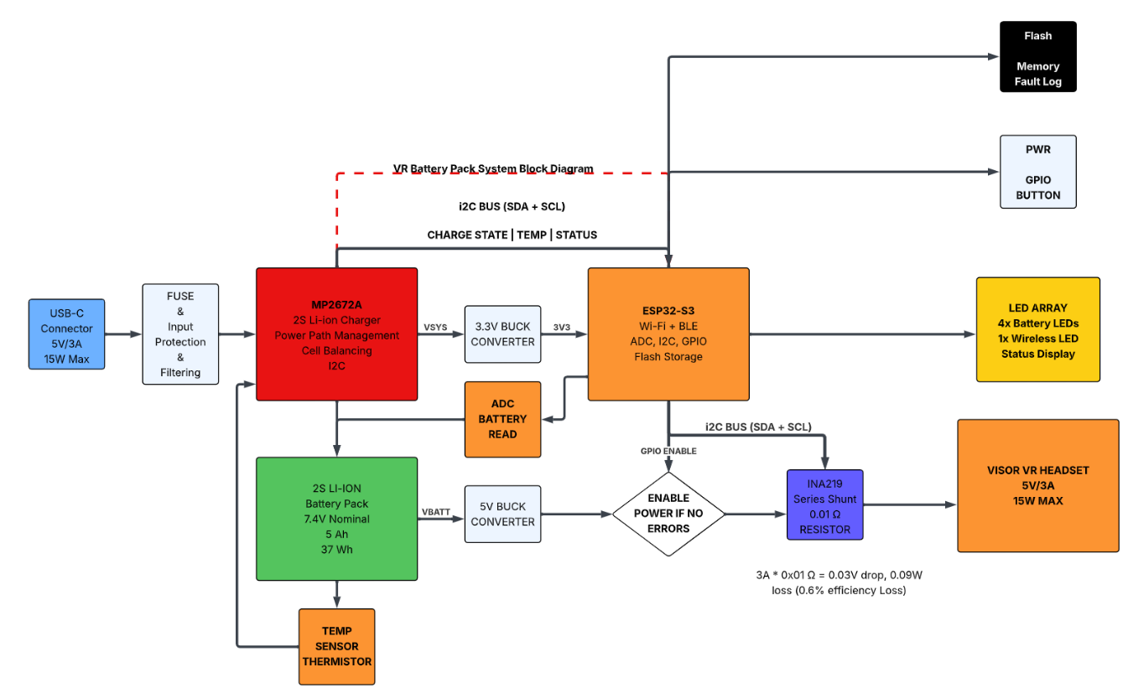
BloCK Diagram Design

Slide 5
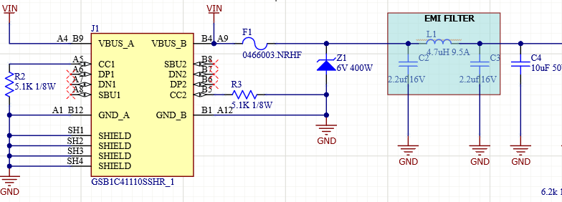
Hardware Design – USB Input
USB C is pulled down to 5.1K (Pulls current)
TVSS Diode Z1 – 6V to deal with voltage spikes, over voltage
F1 3A fast acting fuse deals with currents larger than 3A
EMI filtering, knocks down switching/ringing >= 100 KHZ
Decision was made to not include USB communication protocol using DP/DN

Slide 6
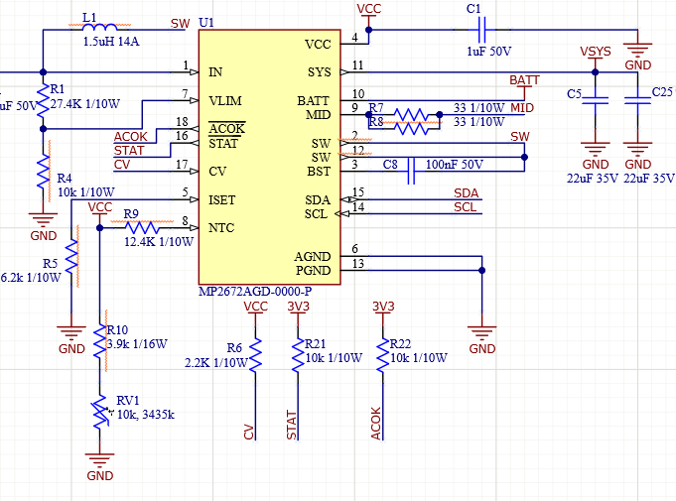
Hardware Design – MP2672A
Decisions Made:
Smart Host Controlled Enabled (CV Pin Pulled to VCC)
VBATT_REG set to 8.4V in Software
I2C runs at 100K, 4.7V pullups on ESP32
NTC Type JEITA (followed recommended values)
STAT AND ACOK pulled to VCC
MP2672A provides:
Cell balancing
Thermal shutdown
Overvoltage protection
Detect USB input
Stop Charge on completion
As well as charge and play!

Slide 7
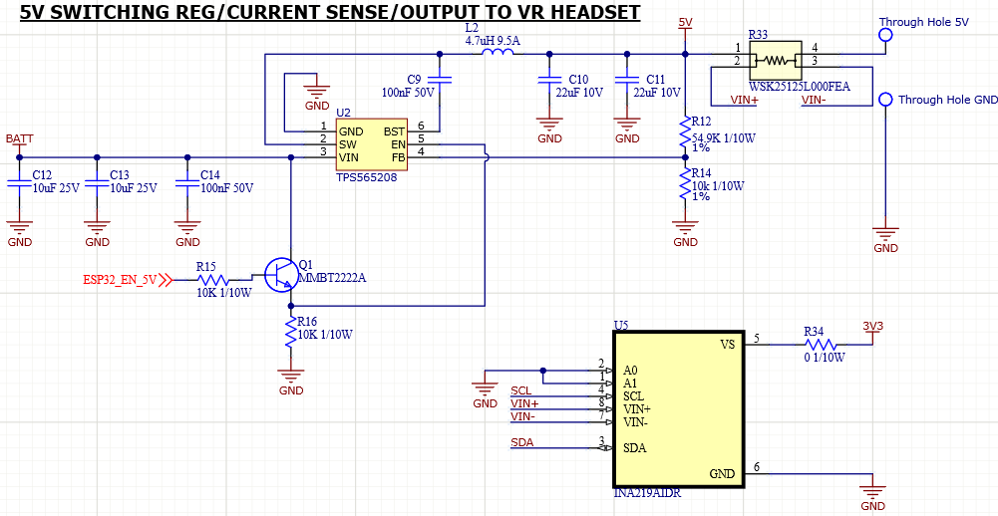
Hardware Design – 5V Switching Reg to VR HEADSET
VBATT bucks Battery voltage to 5V out
Regulator is enabled by ESP32
INA219 is included to monitor output current in case of overload
Utilizing Shunt resistor of 0.01 Ω for minimal power loss

Slide 8
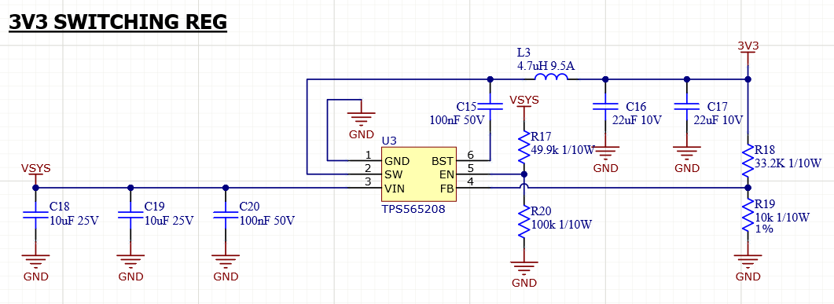
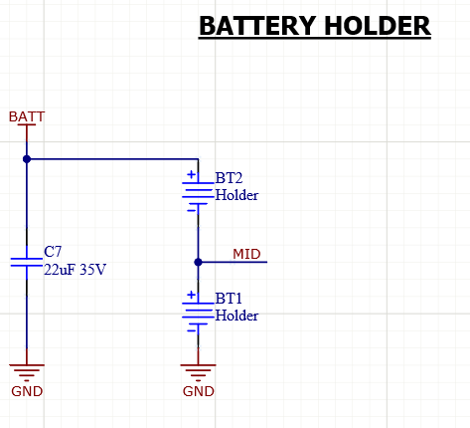
Hardware Design – 3V3 Switching Reg to ESP32 Battery Holder

Slide 9
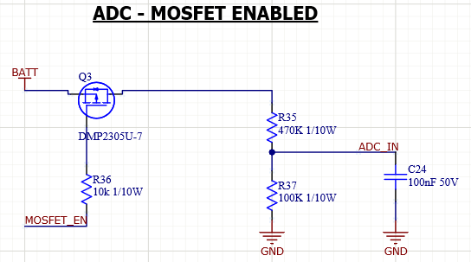
Hardware Design – Limited On time ADC
MP2672A Tells you when batteries are charging but does not inform about voltage level
Included ADC driven by GPIO pin to enable P-Fet to perform ADC read

Slide 10
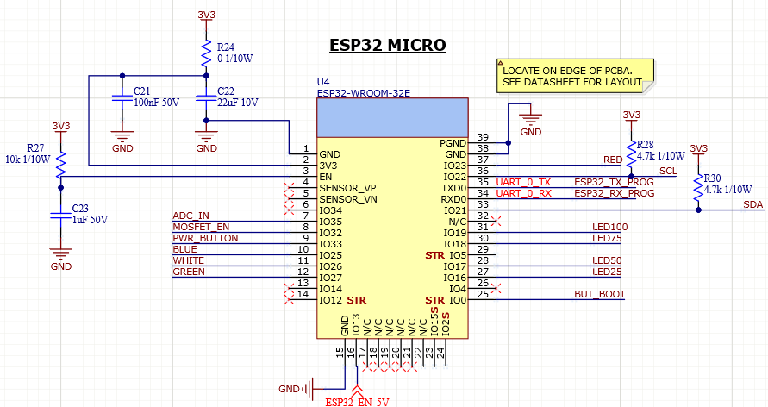
Hardware Design – ESP32
ESP32-WROOM-32E provides dual core BLE + WIFI for logging (if necessary)
I2C pullups included here
EN pin always on as long as VSYS active

Slide 11
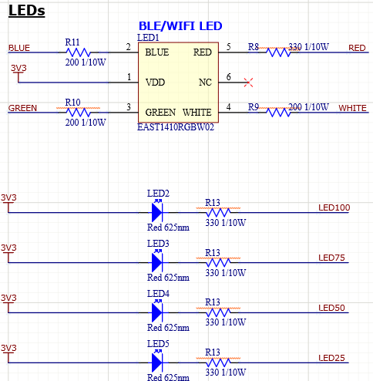
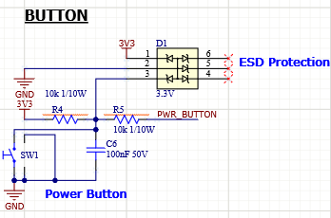
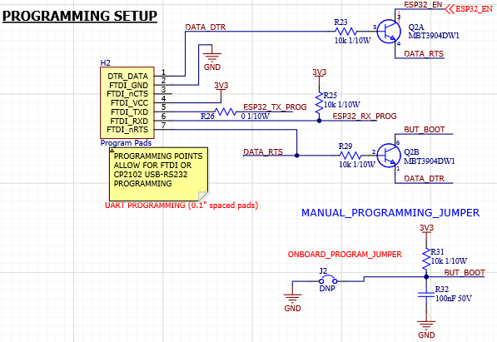
Hardware Design – Button/LED/Programming

Slide 12
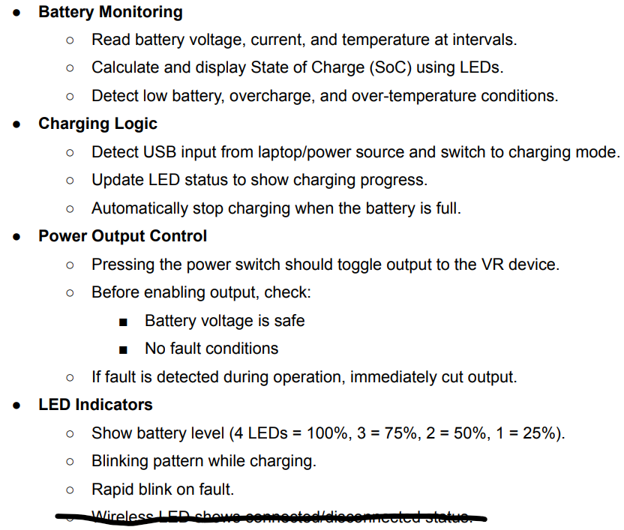
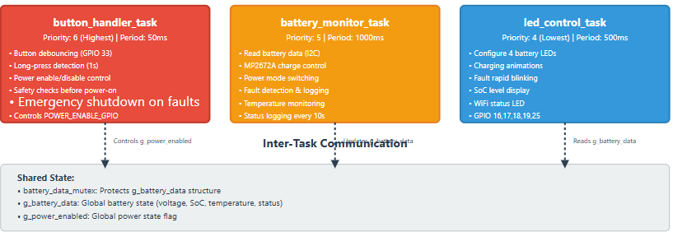
Software Design

Slide 13
Software Design – Task 1 – Battery Monitor
Read battery data – It calls the battery monitor driver to get the latest voltage, temperature, charge status, and health flags.
Update global copy – If it can grab the mutex, it copies this fresh data into a shared global structure so other tasks can safely read it.
Enable charging if safe – If there are no dangerous conditions (like over-voltage, over-temp, over-current, or generic fault), it tells the MP2672A chip “charging is allowed.” The chip itself manages how to charge and power the system.
Log charging status changes – If the charging state changed since last time (for example, from “not charging” to “charging”), it prints a message.
Check for problems – It looks for sensor faults (like a broken thermistor), and for battery warnings/faults:
Critical condition → error log
Low battery → warning log
Over-voltage → error log
Over-temperature → error log
Periodic status log – Every 10 samples, it prints a summary: voltage, percentage, temperature, whether it’s charging, and a human-friendly status string. This is a heartbeat for monitoring.
Wait before repeating – At the end of the loop, it delays for the configured sample period, then does it all again.

Slide 14
Software Design – Task 2 – Battery Monitor
Configure LEDs – Set up the GPIO pins for the 25%, 50%, 75%, and 100% battery LEDs as outputs. Optionally configure the Wi-Fi LED pin if it’s defined.
Turn off all LEDs – Make sure every LED starts in the OFF state.
Define blink timing – Use a fast blink rate (100 ms) for battery faults and a slower blink rate (500 ms) for Wi-Fi disconnected status.
Define fault conditions – Create a mask that treats critical, over/under-voltage, over/under-temp, and over-current as faults.
Read battery data – Lock the mutex, copy the latest battery data into a local variable, then release the mutex.
Fault display – If any fault bits are active, override everything and make all four battery LEDs blink rapidly in sync.
Normal display – If no fault is active, decide how to show the battery level:
If charging → call update_led_pattern to animate LEDs.
If not charging → call update_led_pattern to show solid LEDs for the current charge percentage.

Slide 15
Software Design – Task 3 – Battery Monitor
Configure button GPIO – Set up the button pin as an input with pull-up enabled so a press reads as 0.
Configure power enable GPIO – Set up the power control pin as an output and default it OFF.
Define fault cutoff mask – List which battery faults (critical, over/under-voltage, over/under-temp, over-current) should force power shutoff.
Track button state – Keep variables for press start time, whether it’s pressed, and a flag to prevent ON→OFF toggles during the same press.
Wait for press – When the pin goes low, mark the button as pressed, reset flags, and record the time.
Wait for release – When the pin goes high again, calculate how long it was held.
If it was held long enough, treat it as a long-press action.
On long-press release:
If power is OFF → try to turn it ON, but only if the battery is safe:
If safe → set power enable pin high, mark power as enabled, and log details.
If power is already ON → turn it OFF, unless it was just enabled by this same press (prevents accidental toggle).
Runtime safety cutoff – While power is ON, keep checking battery data.
If any fault in the cutoff mask appears, immediately shut power OFF.

Slide 16
ADC
Configure ADC + divider control – Uses ADC1 (GPIO35) to read combined battery voltage. A PMOS on GPIO32 turns the divider on only when measuring (saves quiescent current). It averages 64 samples, converts with esp_adc_cal, then back-calculates pack voltage using the divider ratio (100k / (220k+100k) = 0.3125).
Use of 11 dB attenuation – ADC_ATTEN_DB_11 targets ~0–3.6 V input range on ESP32 ADC. Divider gating timing – After pulling the PMOS gate low, wait one RTOS tick before sampling. That lets the node settle and reduces measurement error. Then it is shut back off.
MP2672A control
MP2672A control – (REG02[0] EN_SUSP, REG00[4] CHG_CONFIG), and the two modes:
Disable charge + suspend boost → run from battery
Enable normal boost + enable charging
Charge status decode – REG03[3:2] → Not charging / Pre-charge / Fast / Complete. Useful for UI/logs.
Status synthesis – How evaluate_battery_status sets bits from voltage/current/temp/SoC, aggregates into FAULT, and how battery_monitor_is_safe allows OK and LOW but not CRITICAL/FAULT.
NTC – Course temperature buckets from REG06. It returns categories like normal/warm/hot/cold and UNKNOWN.

